Slide 1
EPS 236: Lectures 3 – 6
The 5 deadly sins of data analysis...
And how to avoid them.

Slide 2
What are some of the most common errors made by scientists and engineers analyzing and modeling atmospheric and environmental data ?
Forget/ignore the basic hypotheses underlying statistical inference from data.
Incorrectly fit a ”line” (or more complex model) to data (1): neglect the symmetry between “predictors” and “response” when assessing uncertainties the analysis
Incorrectly fit a ”line” (or more complex model) to data (2): fail to account for autocorrelation of data or predictors
Conflate standard deviation, uncertainty, and confidence intervals in an analysis
Not remember why the best way to assess uncertainties is almost always the bootstrap or its big cousin, the Markov Chain Monte Carlo simulation
Notes:
STATE as the positinve, then exhortation; 2: light bulb slide….4. from some literature, or from our sample problem ← 5. bootstrap

Slide 3
1. Statistical inference
a. Hypothetical concept
b. Resampling
c. Forecasting (markets; treatment effects)
d. Confidence intervals – resampling
e. Confidence intervals and variances
(AKA, Why "errors" and "uncertainty" are so
confusing to physical scientists.)
2. Modeling a physical system
Resampling and forecasting
a. H atom (example)
b. Emissions of natural gas from cities
What question is being asked?
What physical system is being modeled?

Slide 4
Statistical inference, resampling, and forecasts
The process we want to understand can be represented by a quantitative model.
Our measurements represent samples of the results of this process, modified by “errors” (or variability) which can be represented as a probability distribution (usually with zero mean = “unbiased”).
We can never know either the exact values of the parameters of this model, or the exact description of the probability distribution function for the “errors”.
Statistical inference provides estimates of the parameters and the pdf.
A common approach is to obtain an estimate of the likelihood that I would observe the measured values for a given set of model parameters and pdf, and then to select as my “best estimate” the parameters and pdf that give the maximum likelihood.
The framework is hypothetical: there exists a perfect model and a perfect probability distribution.
Our best model is an estimate, as is our set of “uncertainties”.
➔ It is possible to get wrong/biased estimates if my model of the process, or of the errors, is not correct for the system at hand.
Notes:
The "sampling" aspect is more obvious when we have the Markov model in the continuous model. In both cases I can redo the trials with the exact same setup many times and assess the variations of the results. Note in our fields, usually we can't do that !!!

Slide 5
2. Model, predictors, response; data—Symmetry
Ex. 1: Find resistance for the filament of a lightbulb, as a function of T: turn a knob to set the voltage, observe filament with a spectrometer
Set V measure spectrum→ T (absolute measurement! )
0
30
10
VVV
20
Predictor Observation Model_Param
5 ± δ v 1000 ± ε K 100 ± ε’ Ω
7 1155 110
… ... ...
aσ = 2.5x10⁻¹³ ± ε”
E = V²/R = aσT⁴
R = V²/(aσT⁴)
response predictors
σ =
But the data are reversible (invertible)/symmetric: given observed E and resistance, infer voltage: “Inverse modeling” ⬄ “causality”

Slide 6
Example 2: Analysis of a spectral line
The mean frequency provides the energy level.
The gaussian part of the line width gives the lifetime of the emitting state
The Lorentian part gives the velocity / temperature
Plot of the centered Voigt profile for four cases. Each case has a full width at half-maximum of very nearly 3.6. The black and red profiles are the limiting cases of the Gaussian (γ =0) and the Lorentzian (σ =0) profiles respectively.
Comparison of Gaussian (red) and Lorentzian (blue) standardized line shapes. The HWHM (w/2) is 1.

Slide 7
Fitting a model (e.g. a straight line ⬄ a model) to data:
{ Pred , Obs }
{ x_{i} , y_{i} }
Model
y = ax + b

Slide 8
θ = parameters (a,b)
P = prob we get obs data x, given (a,b)
of having produced the observations you obtained.

Slide 9
σ is usually attributed to “measurement error”, for y; no errors are attributed to x
Both usually false!!
to maximize P
minimize sum of squared residuals
Notes:
Relate to the hypothesis; nOTEϖαριανχε is not always attributable to measurement error – in our 2-box example, s is due to fluctuations of a physical process. VERY COMMON in our field !!

Slide 10
Ordinary Least Squares (OLS): “errors” all equal
Weighted Least squares (Chi-square): “Errors” may be different for different observations
OLS:
𝛘² :
So far we have not strayed from the familiar!
Notes:
So far we have not strayed from the familiar!

Slide 11
But there is (almost always) also error (unresolved variance) in the predictor (x) (our “symmetry”).
Look at the relationship between the correlation coefficient ρ, and the OLS Slope (not equal!!!):
ρ = cor(x,y) ≅
symmetric
OLS Slope = ρ σ_{y}/σ_{x}
≅ r SD_{y}/SD_{x}
Why this is a YOOOGE problem
asymmetric
Notes:
note difference between rho (true corr coeff) and r, sample estimate for that!

Slide 12
An example where OLS works very well
y + ε_{y} = a + bx
x= 0:100 ; y= 1 +2*x + ε_{y}
ε_{y} = rnorm(101,2)
Y
x
Notes:
slow OLS slope decreasing with sigma x

Slide 13
… example where OLS works very well
Sample Quantiles
-4 -2 0 2 4
-2 -1 0 1 2
Theoretical Quantiles
OLS passes test for heteroscedacity (no trend in residuals)
OLS discovers noise distribution
(“error variance”)!

Slide 14
“Type II” regressions

Slide 15
“Type II” regressions

Slide 16
Generalized Chi-square regression
Press et al., Numerical Recipes
Notes:
Skip this slide

Slide 17
Generalized Chi-square regression:
y = a + bx
specified errors in both x and y, for each predictor-observation pair.
Results in a non-linear optimization problem. Generalized to multivariate by York.

Slide 19
y1 + ε_{y} = a + b x ; x1 = x + ε_{x}
!!!!
y1
0 5 10 15 20
OLS is biased towards underestimating the slope (…the “yooge” problem)
0 5 10
x1
lmodel2( y1 ~ x1 )
Notes:
OLS is heteroscedastic on average -- residuals have a trend with data

Slide 20
Slopes of Type I & II regressions for the model problem, resampled 1000 times (resampling errors)
MA is best, because the relationship between σ_{x} and σ_{y} is closest to MA assumptions
Regression slope Y1 on X1 – errors in both Y and X.
Notes:
Show your fits for the example problem; EXHORT the troops.; RESAMPLING concept;

Slide 21

Don’t fit OLS models to data with errors in both predictors and response;
test model fit for heteroscedacity e.g. ncvTest!

Slide 22
3. Analyzing and Modeling Autocorrelated Data

Slide 23
What is autocorrelation in a data set, and why is this characteristic so important in analyzing and modeling the data ?
Brief introduction to time series analysis: autoregressive, moving average filtering of noise as a key element in time series.
Variance inflation due to autocorrelation of data—”red shifted noise”.
Using arima models to extract underlying trends and signals from autocorrelated data.

Slide 24
3. First-order autoregressive (Markov) processes
Box, G. E. P., Jenkins, G. M., & Reinsel, G. C., “Time Series Analysis: Forecasting and Control” (Pearson, 1994).
Autoregressive Process (value at time t depends on previous value plus a random forcing):
Definition: z_{t} = ϕ₁ z_{t-1} + a_{t}
z: observed data; t time (discrete, evenly spaced); a random “shocks”; ϕ₁ autoregressive parameter (above is ar(1) process; note zero mean…)
Correlation function for lag k: ρ_{k} = φ₁ ρ_{k-1} ➔ ρ_{k} = φ₁^{k} (decays exponentially, osc if φ <0)
If E[a_{t}²] = σ_{a}² , E[z_{t}²] = σ_{z}² = σ_{a}²/(1 – ρ₁φ₁) = 1/(1 – φ₁²) : Variance increased by 1/(1 – φ₁²) compared to forcing !!!

Slide 25
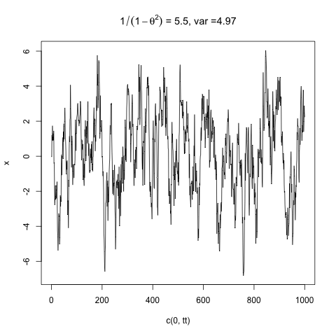
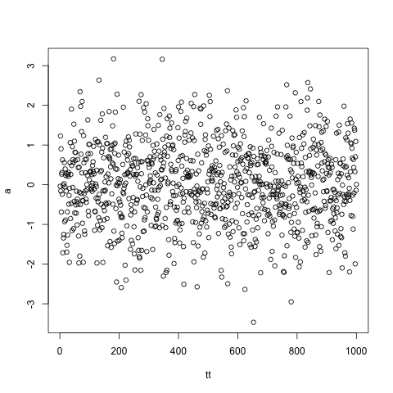
Random impulses with autocorrelation ➔ variance inflation
φ= 0.905 (τ_{decay}=10)
YY[i]=a[i]+ ϕ*YY[i-1]
1/(1 - φ²) = 5.5; var=4.97
rnorm(1000); var= 1
a = rnorm(1000)
➔
-3 0 3
-6 -4 -2 0 2 4 6
Autoregressive Ar(1) <first order…>
Notes:
students do this!

Slide 26
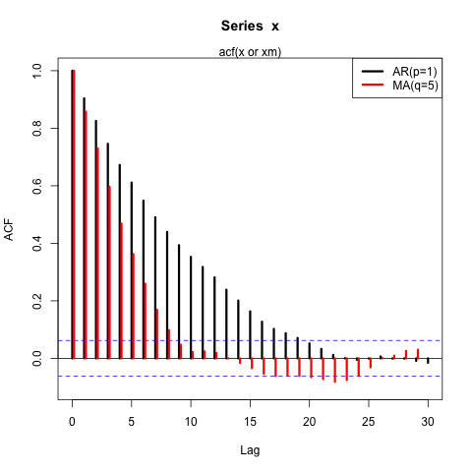
ACF function

Slide 27
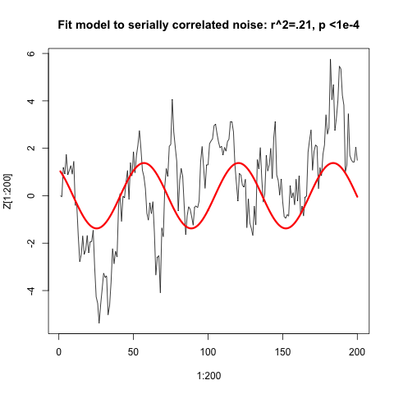
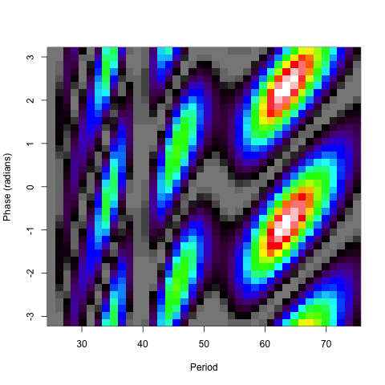
x33=sin((1:200)*2*pi/63.4-.94)
#ls.print(lsfit(x3,x[1:200]))
#Residual Standard Error=1.841 ; R-Square=0.2158
#F-statistic (df=1, 198)=54.4871; p-value=0
# Estimate Std.Err t-value Pr(>|t|)
#Intercept 0.3883 0.1302 2.9821 0.0032
#X -1.3795 0.1869 -7.3815 0.0000
arima(x = Z[1:200], order = c(1, 0, 0), xreg = x3)
#Coefficients:
#ar1 intercept x3
#0.8547 0.3848 -1.2766
#s.e. 0.0360 0.4473 0.5489
## do it again with 5x longer data record
#arima(x = Z, order = c(1, 0, 0), xreg = x33)
#
#Coefficients:
#ar1 intercept x33
# 0.9021 0.1835 -0.4675
#s.e. 0.0135 0.3203 0.3280
sigma^2 estimated as 1.003:
With 200 points, the OLS finds a decent fit and excellent p and F values. But, even with only 200 points, the arima model shows that we cannot reject the null hypothesis: “the time series is serially correlated noise, with no detectable signal”. The longer time series makes a strong case supporting the null hypothesis and it obtains good values for the ar() process.
An autoregressive random time series, like our boxes
The hazards of ar1() data:
There are actually fewer degrees of freedom than you think.
The variance is inflated.
The “redshifted noise” is actually random (in phase), but shows distinct structure associated with the decorrelation time. A very long time series needed to know if it is a signal
Test data with ar() and arima()—efficiently estmate autoregressive coefficient and its significance.
F-statistic
Notes:
HEY, IS THAT THE AMO??
Describe what arima() does: fit a model with a functional form + autoregressive noise!.

Slide 28
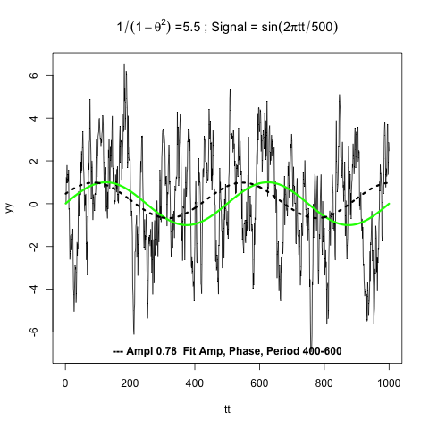
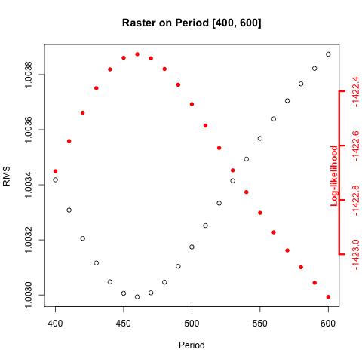
The arima(1,0,0) model determines signal with autocorrelated noise:
it fits a basic model to both! ar() + OLS ….
“Best” model: ar1=0.903, Ampl = 0.78 (s.e.0.4), sigma^2 (est. noise) = 1.001
Period=460, phase shift =-30.
ar1 int sin.t cos.t
ar1 1.00000 0.00609 0.00952 0.00044
int 0.00609 1.00000 -0.06123 -0.10207
sin.t 0.00952 -0.06123 1.00000 -0.05594
cos.t 0.00044 -0.10207 -0.05594 1.00000
Parameter correlation matrix
Forecasting: predict.Arima()

Slide 29
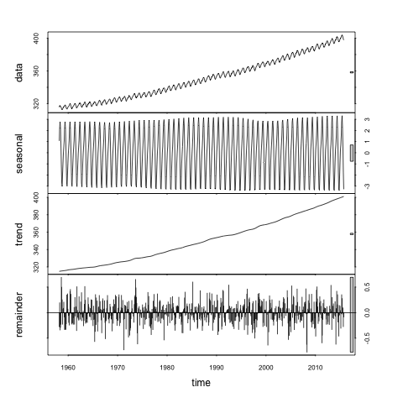
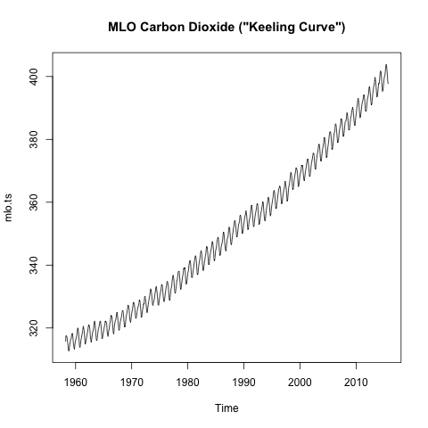
→

Slide 30
Don’t fit OLS models to garbage:
test your data for serial correlation !

Slide 31
4. Estimating and presenting probability distributions and uncertainty (a.k.a. “errors”)
Rigorously estimated errors are essential for data analysis
The standard deviation (σ) measures variation of the sample.
The confidence interval (CI) estimates the uncertainty of the model results (parameters…).
The confidence interval is often estimated using the “standard error” (from MLE) or the “t-test”. These assume errors are Gaussian.
Complex inference (e.g. hierarcharal or sequential/chained models) require a bootstrap or its big cousin, the Markov Chain/Monte Carlo approach.
Notes:
Emphasize what the SD and CI measure: *variance* vs uncertainty.
SD not an error estimate!!!

Slide 32
What is a “confidence interval” (“CI”) ?
The confidence interval is an estimate for the results that would be obtained from resampling (repeating an experiment).
If we could resample an experiment many times, the x% (e.g. 95%) confidence interval encompasses x% (95%) of the trial results.
Example 1: I want to estimate the mean temperature over a geographic area at a particular time. I measure the temperature at N points across the domain, and take the average to obtain an estimate of the mean.
If I repeated this measurement many times, the 95% confidence interval is given the the 2.5 and 97.5 percentiles. I can only make an estimate of the true mean. Even worse, I can’t resample the domain at a past time! I have only the N data points I first measured.
Notes:
RESAMPLING: back to our conceptual framework for statistical inference.

Slide 33
Standard deviation (σ) or variance (var)
vs
confidence interval (estimated error or uncertainty)
Standard deviation measures the width of the probability distribution of your sample: estimates of σ will be refined as the sample gets larger. Estimates of the CI get smaller as the sample gets larger.
Density: rnorm(50)
Density: rnorm(1e6)
mean= - .12
CI = (-.13, .34)
range 0.5
mean= .001
CI = (-..0006,
.003)
2σ
SD=0.85
2σ
SD=1.0

Slide 34
Histogram of 50 samples drawn from the normal distribution, compared to the (“true”) normal distribution

Slide 35
Example:
Estimate the mean of normally distributed data, N = 100 points, resampling the “true”
Gaussian (Normal) pdf.
“True”: mean =0
σ = 1 (std dev)
Histogram of resampled true pdf mean(rnorm(100) )
Resample 1000 times:
-.3 -0.2 -0.1 0 0.1 0.2 0.3
ZZ=NULL ; for(k in 1:1000)
ZZ=c(ZZ,mean( rnorm(100) ) ) quantile(ZZ,probs=c(.025,.975))
2.5% , 97.5% ➔ -0.20, 0.20, CI range= 0.4
Sample Mean

Slide 36
Estimating errors using non-parametric resampling
The bootstrap method resamples the original data set, i.e. if I can’t repeat the measurements. We use its N data points to generate a large number of synthetic data sets, each also with N data points.
The procedure is simply to draw N data points at a time with replacement from each synthetic data set. Because of the replacement, we do not simply get back our original data set each time. We get sets in which a random fraction of the original points, on average 1/e ≈ 37% , are replaced by duplicated original points.
Subject the original data and the synthetic data sets to the same estimation procedure (mean; MLE/Chi-square model inversion, …) to obtain parameter estimates.

Slide 37
Example:
Estimate the mean of normally distributed data, N = 100 points, using a bootstrap.
“True”: mean =0
σ = 1 (std dev)
mean of original sample
mean of true pdf
Resample 100 data 1000 times:
Zum=rnorm(100)
RR=NULL ; for(k in 1:1000)
RR=c(RR,mean(sample(Zum,100,replace=T) ) ) quantile(RR,probs=c(.025,.975))
2.5% , 97.5% ➔ -0.38 0.020 range 0.40
same range as sampling rnorm itself!
-0.4 -0.2 0 0.2
Sample Mean
Notes:
CI does include ”true” mean, but almost didn’t because our sample had notable bia relative to true

Slide 38
The set of estimated parameters will be distributed around the best estimate of the parameters from the original data (a(0)) in close approximation to the way that a(0) is distributed around a_{true} as in our simple example.

Slide 39
Markov chain – Monte Carlo concept to obtain the CI
A. Resample the underlying model: we can re-do the experiment

Slide 40
B. Resample the original data : we cannot re-do the experiment

Slide 41
Some critical things to take away from these lectures
The basic hypotheses underlying statistical inference from data: the hypothetical “true” model or parameter value, and the equally hypothetical pure pdf that controls my sampling.
There is an underlying symmetry between “predictors” and “response”: functional relationships, errors
Autocorrelation of (among) data and predictors is endemic in our fields and has a very strong influence on results
Use central values, standard deviation, uncertainty (standard errors), and confidence intervals correctly and be explicit
The bootstrap or its big cousin, the Markov Chain Monte Carlo simulation, are incredibly useful tools for exploring the uncertainty structure of your problem. They focus on repeated simulation and resampling of your data, or your complete data-model framework.
Notes:
STATE as the positinve, then exhortation; 2: light bulb slide….4. from some literature, or from our sample problem ← 5. bootstrap

Slide 42
Finis
Lectures 3 - 6
Notes:
wrap up

